Slide 1








Data Analytics Portfolio:
Flight Delay Cause Analysis
Output: Dashboard Visualization with Tableau
Presented by Raon Spielberg Berek
Junior Data Analyst
Tools used:

Slide 2




About me:
Hi, I'm Raon Spielberg Berek, a final-year Information Systems student at Harapan Bangsa Institute of Technology and a Junior Data Analyst. I possess strong public speaking and analytical skills, honed through experience coordinating numerous projects and events, as well as working on various data analysis projects using Excel, SQL, Python, Tableau, PowerBI, and Looker.
Employment Objective:
A career in Information Systems, specifically in the areas of Data Analysis, leveraging proficiency in data analysis and visualization tools (SQL, Python, Tableau, etc.), and analytical thinking and communication skills, to translate complex data into actionable insights and guide clients through their transformation journey.
Kalideres, West Jakarta
raonbereknew@gmail.com
Raon Spielberg Berek

Slide 3




Experience and Certifications
Data Mining Lab Assistant Lecturer
- Institut Teknologi Harapan Bangsa, Bandung City
Feb 2025 - Jun 2025
Data Scientist Intern (Project-Based)
- PT IDX Consulting, Online
Mar 2025 - Mar 2025
Machine Learning Distinction Graduate
- Google Bangkit Academy 2024 Batch 1, Online
Feb 2024 - Jun 2024
Learn Data Analysis with Python
- Dicoding Indonesia, Online
Mar 2024 - Mar 2024

Slide 4
Agenda
1
About the Project: Business Understanding
4
Modeling and Evaluation (Tableau Dashboard)
2
Data Understanding
5
Strategic Recommendations to Reduce Delays
3
Data Preparation
6
Deployment (Tableau Public)

Slide 5

Business Understanding
Background:
The aviation industry relies heavily on time efficiency to maintain smooth operations.
Flight delays represent a recurring issue that leads to significant financial losses for airlines.
Delays negatively impact customer satisfaction and trust. They also disrupt airport efficiency and overall operational performance.
Image Source: NewsBytes
Dataset provided:
Name: Airline On-Time Statistics and Delay Causes.
Source: Bureau of Transportation Statistics (BTS), USA.
Time Range: May 2023 – May 2025.
Dataset covers flight schedules, delays, and their contributing factors.

Slide 6

Business Understanding - Problem Statements
Based on the background, management needs, and the dataset provided, the following problem statements will be addressed in this project.
What are the different types of flight delays and how many delays fall into each category?
What are the top-ranking causes of flight delays based on their frequency of occurrence?
How do carrier-related delays rank in terms of total delay counts?
How has the average percentage of carrier-related delays changed over time?
How is the total delay distributed across U.S. states and cities?
Image Source: istockphoto

Slide 7

Business Understanding - Project Objectives
To address the identified problem statements, the following project objectives are defined. An interactive dashboard will be developed with filters for month, year, airport name, state, and city, featuring the following visualizations:
Scorecards displaying the total number of delays and the count of each delay type.
Bar chart showing the ranking of delay causes by frequency of occurrence.
Bar chart ranking airlines based on the number of carrier-related delays.
Line chart illustrating the trend of the average carrier delay percentage over time.
Map chart highlighting flight delay hotspots across U.S. states and cities.
Image Source: Canva

Slide 8
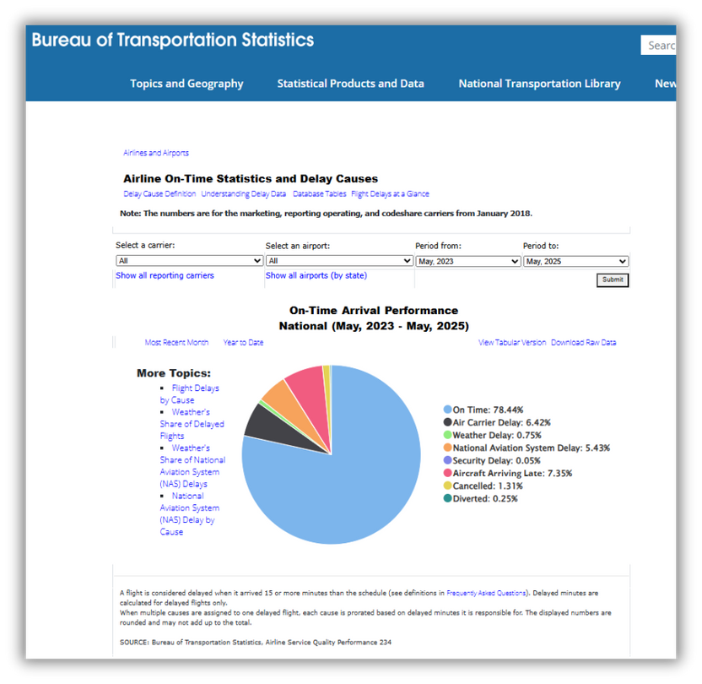
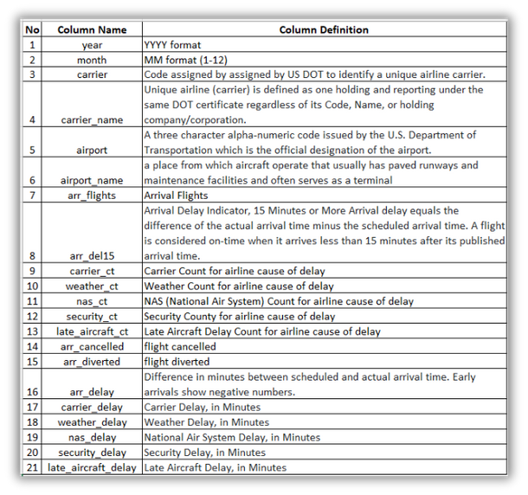

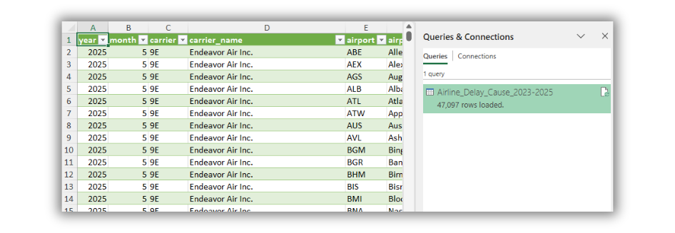
Data Understanding
The dataset contains 21 columns related to airline on-time statistics and delay causes.
Most columns record the number of delays by type and the duration of delays (in minutes).
The column arr_del15 is an arrival delay indicator:
≥ 15 minutes → Delay
< 15 minutes → On-Time
Total records: 47,097 rows (from May 2023 – May 2025).
57 rows contain missing values.
Data types:
Text → 4 columns
Whole Number → 12 columns
Decimal → 5 columns
Dataset Source: https://www.transtats.bts.gov/OT_Delay/OT_DelayCause1.asp?20=E

Slide 9
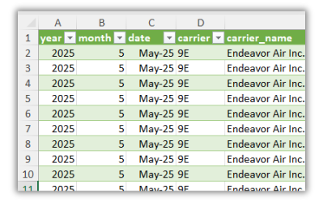
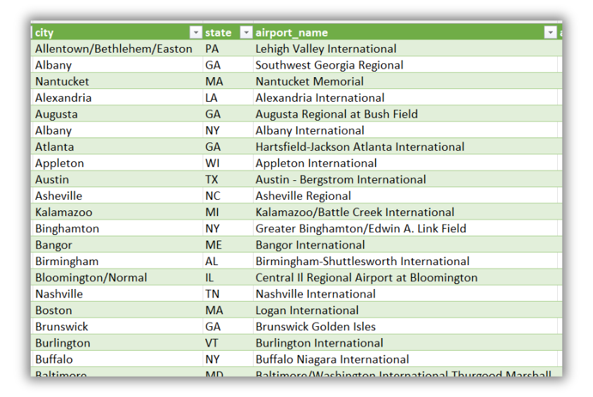
Data Preparation
Dropped 9 irrelevant columns:
arr_flights, arr_cancelled, arr_diverted
Delay duration columns (in minutes): arr_delay, carrier_delay, weather_delay, nas_delay, security_delay, late_aircraft_delay
Removed rows with missing values (57 rows).
Created a new column date (Month-Year format).
Extracted city and state from airport_name into separate columns, and trimmed extra spaces.

Slide 10
Modeling & Evaluation - Tableau Worksheets
Filters:
Viz 1: Scorecards
Insights:
All filters function as intended, successfully filtering the data across the entire dashboard.
The first visualization (Viz 1) displays the total count of delays for each of the five cause categories: Carrier, Late Aircraft, NAS, Security, and Weather Delay.
Late Aircraft Delay is the most frequent cause, accounting for over 1.1 million incidents, while Security Delay is the least frequent, with fewer than 8,500 incidents.

Slide 11
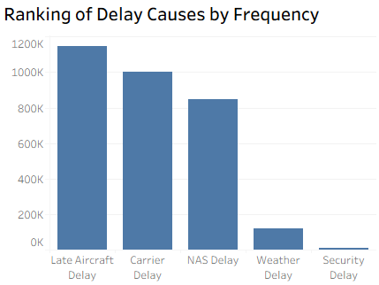
Modeling & Evaluation - Tableau Worksheets
Viz 2: Bar Chart
Insights:
Top 3 Delay Causes: Late Aircraft Delay, Carrier Delay, and NAS Delay.
Delays from late-arriving aircraft (Late Aircraft Delay) are the primary driver, indicating efficiency issues in connecting flight schedules.
Two of the top three causes (Late Aircraft & Carrier Delay) are directly within the airline's control, accounting for the vast majority of all incidents.
By frequency, delays from external factors like Weather and Security are far less common than internal operational issues.
To achieve the greatest impact, prioritize improvements in aircraft turnaround efficiency and crew scheduling.

Slide 12
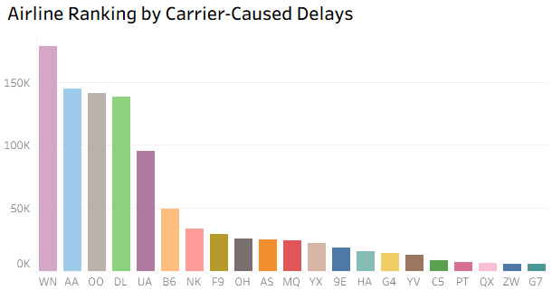
Modeling & Evaluation - Tableau Worksheets
Viz 3: Bar Chart
Insights:
A small group of airlines, led by Southwest (WN), American (AA), and SkyWest (OO), are responsible for the highest volume of self-inflicted delays.
The top 5 airlines account for a disproportionately large share of all carrier-caused delays, indicating that industry-wide issues are heavily concentrated within these key players.
A clear performance gap exists between the top-ranking airlines and the rest of the industry, highlighting a wide variation in operational efficiency and reliability.
Focus operational improvement efforts on the top 5 carriers to address the root causes of their delays for the most significant industry-wide impact.

Slide 13
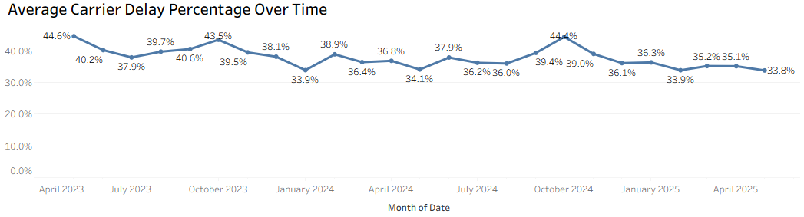
Modeling & Evaluation - Tableau Worksheets
Viz 4: Line Chart
Insights:
The percentage of carrier-caused delays does not occur randomly; it follows a predictable seasonal cycle year after year.
While performance is strongest in the winter (Jan), it consistently worsens into a challenging period from late summer through fall (August - November), culminating in the year's highest delay percentages in October. A smaller, secondary peak is also visible in the spring.
The average delay percentage fluctuates by more than 10 points annually (from ~34% to ~45%), indicating significant volatility in airline operational reliability throughout the year.
Airlines should leverage this predictable seasonality for proactive resource planning, with a critical focus on preparing for the demanding late summer and fall peak, in addition to the spring challenges.

Slide 14
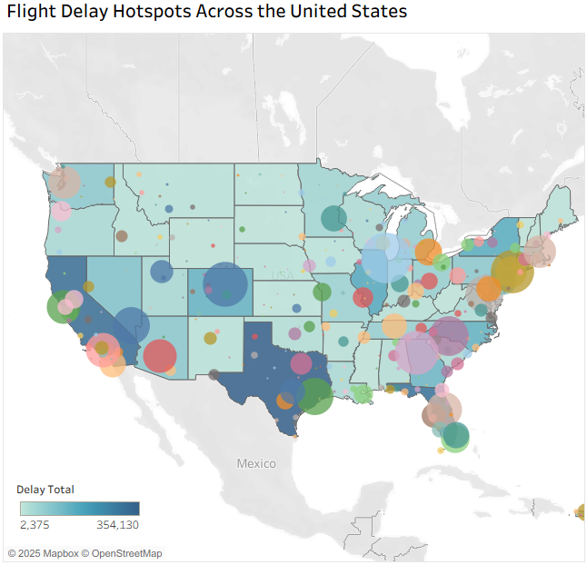
Modeling & Evaluation - Tableau Worksheets
Viz 5: Map Chart
Insights:
The total impact of flight delays is not spread evenly across the country but is heavily concentrated in a handful of major hub airports and high-traffic regions.
Key delay hotspots are clustered around the nation's busiest airports, including those in the Northeast (NYC area), Midwest (Chicago), Southeast (Atlanta), and on the West Coast (California).
The map reveals a pattern where delays are most prominent on the East and West coasts, with significant inland hotspots appearing exclusively at major connecting hubs like Denver and Dallas.
For the greatest national impact, focus delay-reduction initiatives and resources on the top 15 hotspot airports, as improvements in these critical locations will ripple positively throughout the entire system.

Slide 15
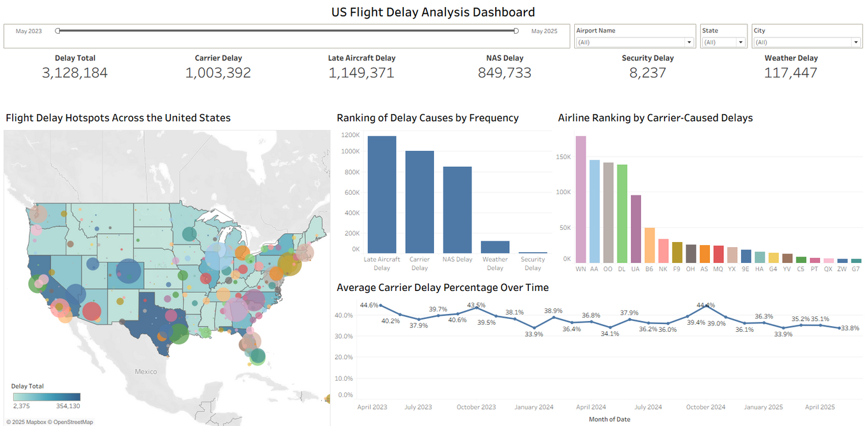
Modeling & Evaluation - Tableau Dashboard
Insights:
While total delays are massive, the issue is not widespread. The impact is heavily concentrated within a few key hub airports and driven by a small number of major airlines.
The vast majority of delays stem from internal airline operations—the "domino effect" of late aircraft and carrier-specific issues—rather than external factors like weather or security.
Airline operational performance is not random; it follows a clear seasonal cycle, consistently worsening in the late Summer through Fall.
A targeted strategy focusing on improving operational efficiency at key hotspot airports during predictable peak seasons will yield the most significant reduction in delays nationwide.

Slide 16
Conclusion
1
The Problem is Concentrated
Flight delays are not a widespread issue but a concentrated one, with the largest impact originating from a handful of key hub airports and major airlines.
2
The Root Cause is Operational
The primary driver of delays is overwhelmingly operational, stemming from internal airline efficiency rather than external factors like weather or security.
3
The Pattern is Predictable
Delay patterns are not random but cyclical, following a consistent seasonal trend that consistently peaks in the late summer and fall, allowing for proactive measures.

Slide 17
Strategic Recommendations to Reduce Delays
1
Launch a Targeted Efficiency Program at Key Hubs
Why: Our analysis shows that the vast majority of delays are operational and highly concentrated within a few major airports.
Action: Conduct a deep-dive review of aircraft turnaround processes and crew scheduling at the top 15 hotspot airports to identify and resolve critical bottlenecks.
2
Implement Proactive, Seasonal Resource Planning
Why: Performance data reveals a predictable seasonal cycle, with operational delays consistently peaking during the late Summer and Fall months.
Action: Develop an enhanced resource allocation plan for ground staff, technicians, and reserve crews to prepare for these identified high-risk periods.

Slide 18

Deployment (Tableau Public)
:
US Flight Delay Cause Analysis Dashboard
:
US Flight Delay Cause Analysis Dashboard by raonsb

Slide 19


Thank You
If you have any questions, discussions, or potential collaborations,
please feel free to contact me through the details below.
raonbereknew@gmail.com
Raon Spielberg Berek
@raonsb

